Slide 1
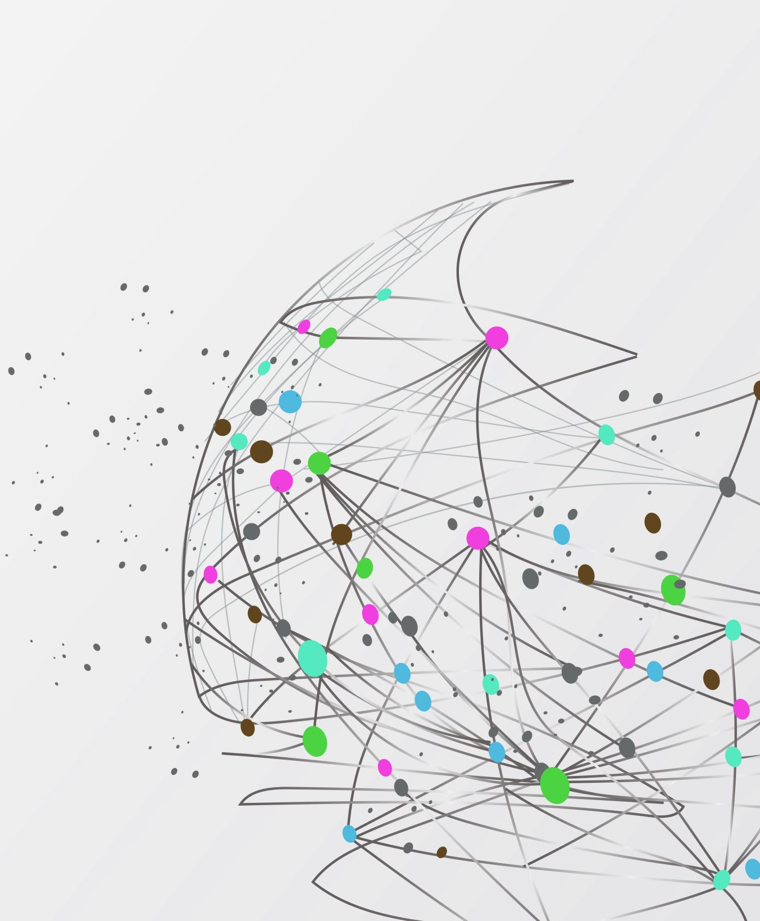
University Campus Network Design
Yasser Zaher 202201077 Yehia Hesham 202202135 Mostafa Mohamed 202202060 Ahmed Wael 202201415

Slide 2
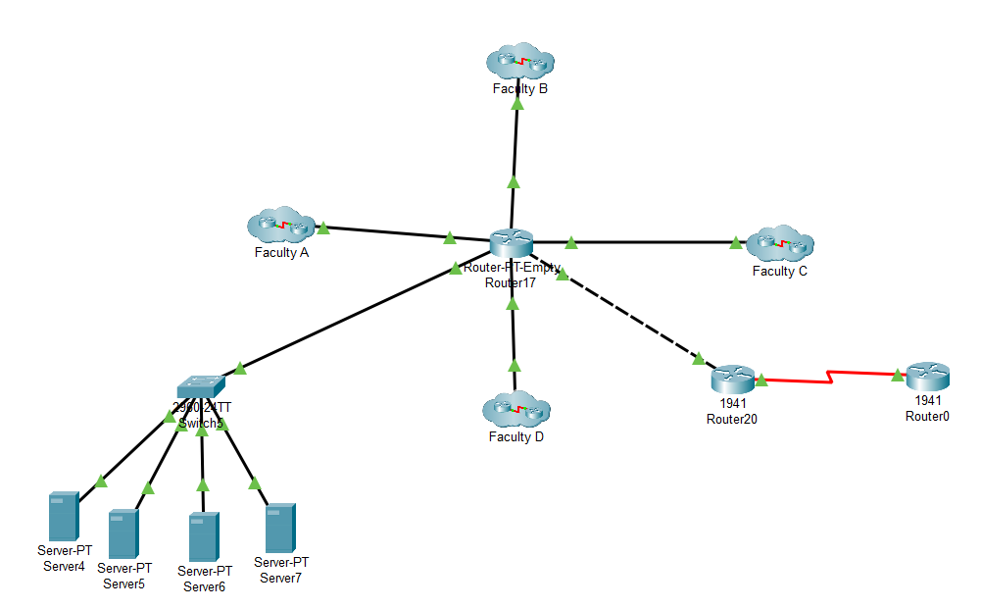
Introduction
The objective of this project is to design an efficient network for a university campus. Its purpose is to connect faculties, laboratories, and the Scientific Computation Center, ensuring seamless access to both internal and external networks. The scope of the project includes a hierarchical design that incorporates routing, VLAN configurations, and optimized IP addressing to meet the campus's networking needs effectively.

Slide 3
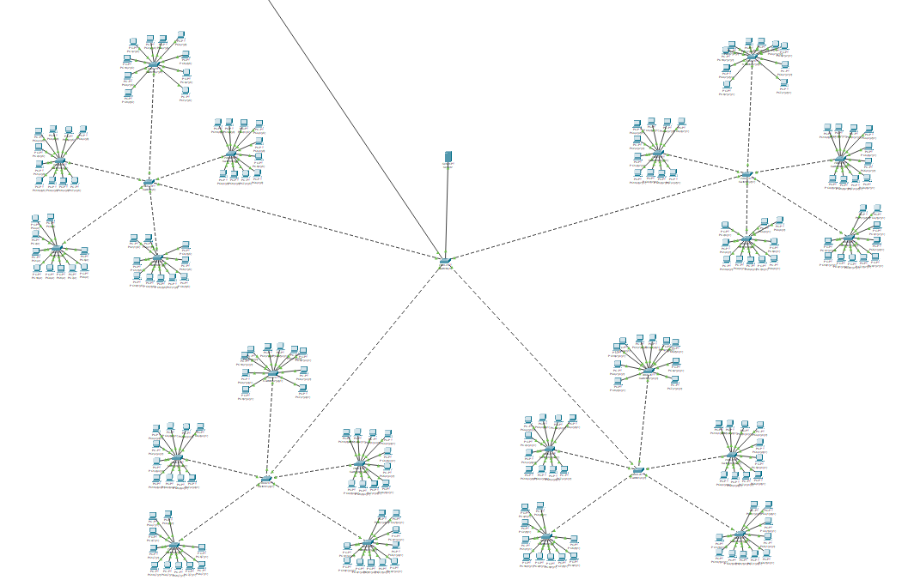
Faculties
4 faculties, each with 4 floors.

Slide 4
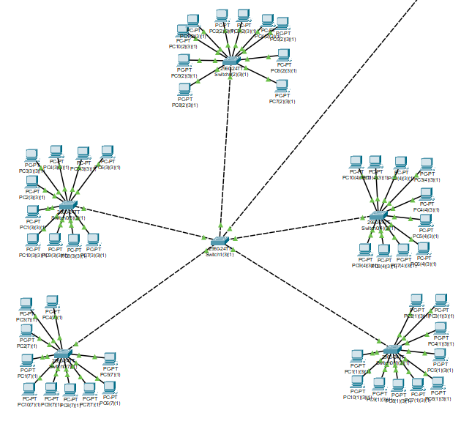
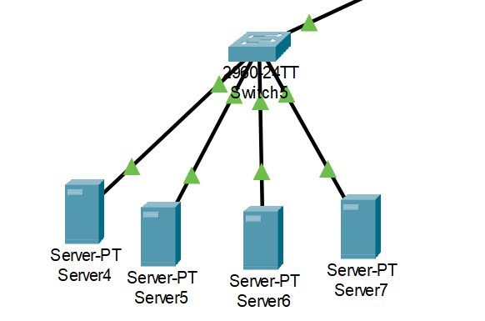
Labs & Scientific Computation Center
Scientific Computation Center
Labs

Slide 5
Connections
o All lab switches on a floor connect to a floor switch.
o Floor switches connect to a main faculty switch.
o The main faculty switch and Scientific Computation Center connect to the university router.
External Connectivity: The university router links to the World Wide Web.

Slide 6
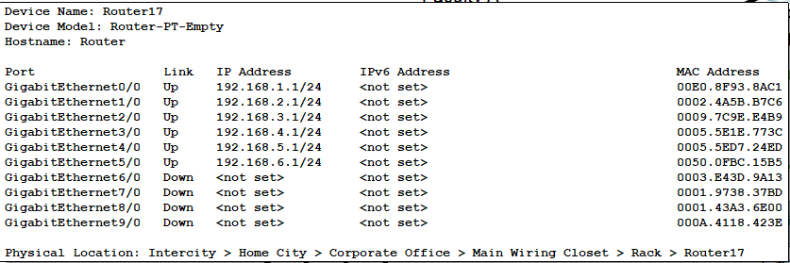
IP Addressing
• Classless IP addressing optimizes the use of public IP addresses across networks.

Slide 7
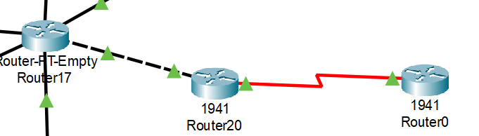
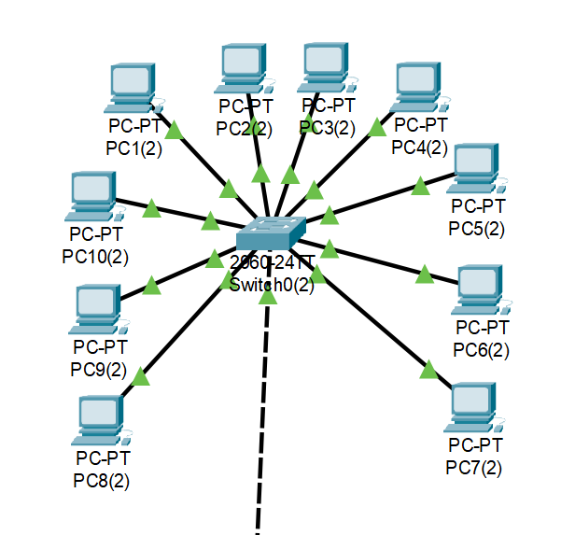
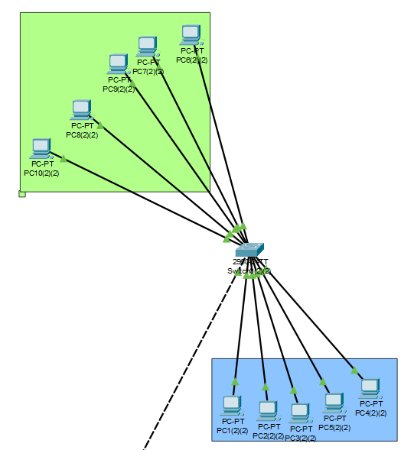
Topologies
Routing and VLAN
RIP for inter-faculty and center data routing.
VLAN configurations to segment network traffic efficiently
Labs: star topologies.

